Slide 1
INSTRUMENTATION
Internal (30)marks Evaluation
Attendance -4
Unit test -8
Final Assessment -12
Tutorials -6
Can be modified and changed.
Prepared By: Anil Kumar yadav Assistant Professor Nepal Engineering College (nec)
References
“Electronics and Electrical Measurement and Instrumentation System”-A.K Sawhney
“Electronics and Electrical Measurement and Instrumentation System”-J.B. Gupta
“Electrical instrumentation”-Bakshi
“modern Electronic Instrumentation and Measurement Techniques”-A.D. Helfrick and W.D.Cooper
“Digital and Analogue Instrumentation testing and measurement”-Nihal Kularatna

Slide 2
INSTRUMENTATION
Course Contents:
Introduction to Instrumentation System. [10 hrs]
Principle of Analog Instruments . [7hrs]
Electrical Signal Processing and Data Acquisition [7 hrs]
Data Converter and Connectors [8 hrs]
Wave Analyzers and Digital Instruments [8 hrs]
Recorders, Displays and Storage Devices [5 hrs]

Slide 3
Ch-1 Introduction to instrumentation system
Some Definitions
Measurements:
-means to monitor a process or a operation and using an instrument ,express the parameter, quantity or a variable in terms of meaningful numbers
-measurement of a given quantity is essentially an act or the result of the comparison between the quantity(whose magnitude is unknown) and a predefined standard
-For the result to be meaningful, there are two basic requirement:
The comparison standard is accurately defined and commonly accepted
2. The procedure and the instrument used for obtaining the comparison must be provable

Slide 4
Statement by famous Physicist Lord Kelvin:
“I often say that when you can measure what you are speaking about and can express it in number ,you know something about it ; When you can not express it in number your knowledge is of unsatisfactory kind”
Measurand:
-The physical, chemical, electrical quantity, property, process, variable or a condition to be measured is referred to as measurand
eg. Physical-length,force,mass electrical- voltage,current ,power

Slide 5
Measurement system:
-Consists of a transducing element which convert the quantity to be measured in an analogous form
-The analogous signal is then processed by some intermediate means and
-is then fed to the end device which present the result of measurement for the purpose of display or control
Transducing Element
Intermediate Means
End Device
measurand

Slide 6
Instrument:
-Device for determining the magnitude of a quantity or variables.
-Physical means of determining quantities or variables.
Instrument Types:
Mechanical instruments.
Electrical instruments.
Electronics instruments.
1. Mechanical Instruments:
Very reliable for static and stable conditions.
Unable to respond rapidly for dynamic and transient conditions.
Instrument moving part is rigid, heavy, bulky & have large mass etc.
It causes obstacle to rapid change in dynamic conditions.
Mechanical instruments creates noise pollution.

Slide 7
2. Electrical Instruments
Comparatively rapid than mechanical method.
Normally, electrical system depends upon mechanical system which has some inertia.
Therefore, electrical instruments have limited time response.
Electronic Instruments
In electronic device, the only movement involved is that of electrons.
Since electrons have very small inertia, the response time becomes very fast. (eg. CRO yields response in ns)
In general electronics have: i) Higher sensitivity ii) Faster response iii) Greater flexibility iv) Small in size & less in weight v) Lower power consumption vi) Higher reliability etc.

Slide 8
Classification of instruments
Absolute Instruments
Secondary Instruments
Absolute Instruments
Provide the magnitude of quantity under measurement in terms of physical constants of instrument.
eg. Tangent galvanometer, Rayleigh’s current balance.
2. Secondary Instruments
It is so designed that the quantity being measured can be measured by observing the output indicated by instrument.
It is calibrated by comparison with an absolute instrument or secondary instrument which already calibrated against absolute instruments.
eg. A voltmeter, A glass thermometer, & A pressure gauge etc.

Slide 9
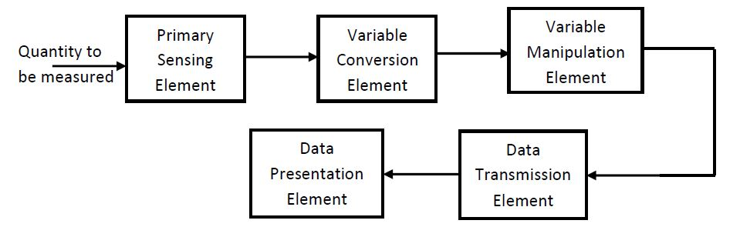
Instrumentation System:
-It consists of different components which together are used to perform a measurement and record the results.
Generalized block Diagram of Instrumentation System
(Functional element of instrumentation s/m or Measurement s/m)

Slide 10
1.Primary Sensing Element
-The quantity under measurement makes its first contact with primary sensing element called as transducer
-A transducer is a device which converts a physical (non electrical) quantity into an electrical quantity. e.g. Microphone, LDR etc.
2. Variable Conversion Element
-The output of the primary sensing element may be electrical signal of any forms.
-It may be voltage or current or other electrical parameters.
-Sometimes this input is not suited to the system.
-For digital system, this analog signal will have to be converted into digital form.
-For example: ADC (Analog to Digital Converter)

Slide 11
3. Variable Manipulation Element
-The function of this element is to manipulate the signal present to it preserving the original nature of the signal.
-Manipulation here means only a change in numerical values of the signal.
-e.g. Electronic Amplifier which accepts a small voltage signal and produces an output signal of greater magnitude.
-Signal amplification and attenuation task is performed in variable manipulation element
-Combined form of variable conversion and variable manipulation is known as signal conditioning element

Slide 12
4. Data Transmission Element
-When the elements of an instrument are actually physically separated, it becomes necessary to transmit data from one point to another.
-The element that performs this task is called data transmission element
-For example, space crafts are physically separated from the earth station where the control stations guiding their movements are located.
-Therefore, control signals are sent from these stations to space craft by telemetry system using radio signals.
-The signal conditioning and transmission stage is commonly known as intermediate stage

Slide 13
5. Data Presentation Element
-The information about the quantity being measured should be displayed appropriately for monitoring, control and analysis purpose.
-In this case, data to be monitored needs visual devices. e.g Ammeter, voltmeter, LCD Display ,VDU(video display unit)etc.
-also called terminating stage of instrumentation system

Slide 14
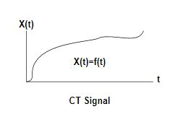
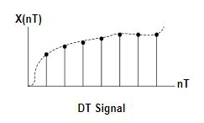
Types of signal in instrumentation system
Signal
- A function of one or more independent variable which contains information is called signal
Types of signals:
Continuous time and Discrete time signal:
Continuous signal
-is defined continuously in time domain
-independent variable is ‘t’
-represented by x(t)
Discrete signal
-is defined only at certain time interval
-independent variable is ‘n’
-represented by x[n]

Slide 15
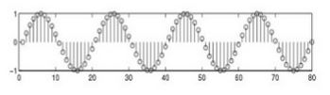

ii) Deterministic and Non Deterministic signal:
Deterministic Signal
-are those signal which can be completely specified in time
-pattern is regular
-nature and amplitude at any time can be predicted
-Eg. X(t)=3sin(4t)
Non Deterministic signal
-is one whose occurrence is always random in nature
-pattern is quite irregular
-also called random signal
-Eg. Thermal noise

Slide 16
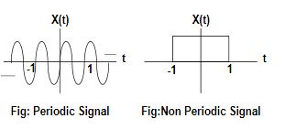
iii) Periodic & Non Periodic Signal:
-Periodic signal is that which repeats itself over a certain interval of time regularly.
-signal x(t) is said to be periodic with T: If x(t + T) = x(t)
- If the signal violates the above condition, then it is called non periodic signal. i.e. x(t + T) ≠ x(t)

Slide 17
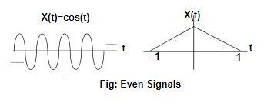
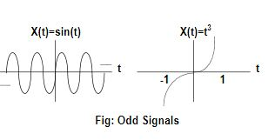
iv)Even & Odd Signal:
Even Signal
-Exhibits symmetry in time domain
-signal is identical about origin
x(t) = x(-t) eg. Cosine wave series
Odd Signal
Exhibits anti-symmetry in time domain
x(t) = -x(-t) eg. sine wave series

Slide 18
v)Energy and power signal:
Energy Signal
-Has finite energy and zero average power
0<E<∞ and P=0
-eg. Non periodic signal
-are time connected
Power Signal
-has finite average power and infinite energy
0<P<∞ and E= ∞
-eg. Practical periodic signal
-exists over infinite period of time

Slide 19

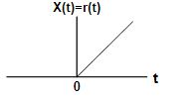
vi)Unit step signal:
It has constant amplitude of unity for the zero or positive values of time whereas zero value for negative value of time.
u(t) = { 1 for t≥0
{ 0 otherwise
vii)Unit ramp signal:
-The value of unit ramp signal increases linearly with increase in time.
r(t) = { t for t≥0
{ 0 otherwise

Slide 20
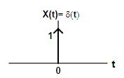
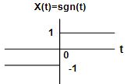
viii) Delta/Unit Impulse Function:
A delta function is defined only at t = 0 with width tends to zero.
δ(t) = { 1 for t=0
{ 0 Otherwise
ix) Signum Function:
A Signum function is an odd or asymmetrical function guided by the following mathematical equation
sgn(t) = { 1 for t>0
{ 0 for t=0
{ −1 for t<0

